Slide 1
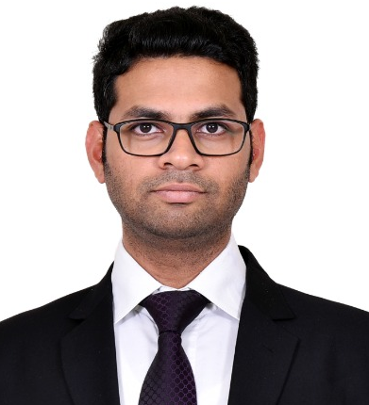
1 year of experience in areas of Market Mix Modelling Project such as Media Mix, Purchase Funnel modeling, Ecomm Models.
4+ years of MNC experience in the petrochemical industry having skills in Project Management, Technical analysis, Vendor Management, Client and Cross-team coordination.
Experience in college Projects on machine learning techniques and algorithms, such as Regression, Decision Trees, Clustering, and Recommender Systems.
Experience working in DDE 1.0, DDE 1.5, Megastar, Python, SPSS, SQL, Tableau, Power BI, and Google Analytics.
A customer-oriented, multi-tasking professional with strong analytical and interpretative skills to organize, analyze and project the data story with high precision, accuracy and clarity.
Pro team player, enthusiastic about new ideas and POVs, initiative taker, and highly adaptable to the changing environment and technologies.
Kartikaya Sahu
Associate Consultant
Prior Experience
Tecnimont Pvt. Ltd.
Design Engineer
Higher Graduation
PG Diploma in Management, in Business Analytics from Welingkar Bangalore.

